Slide 1
SchoolCity Student Screens
Danece Mangone
dgmangone@graniteschools.org
385-646-4376

Slide 2
Student Launch Pad

Slide 3
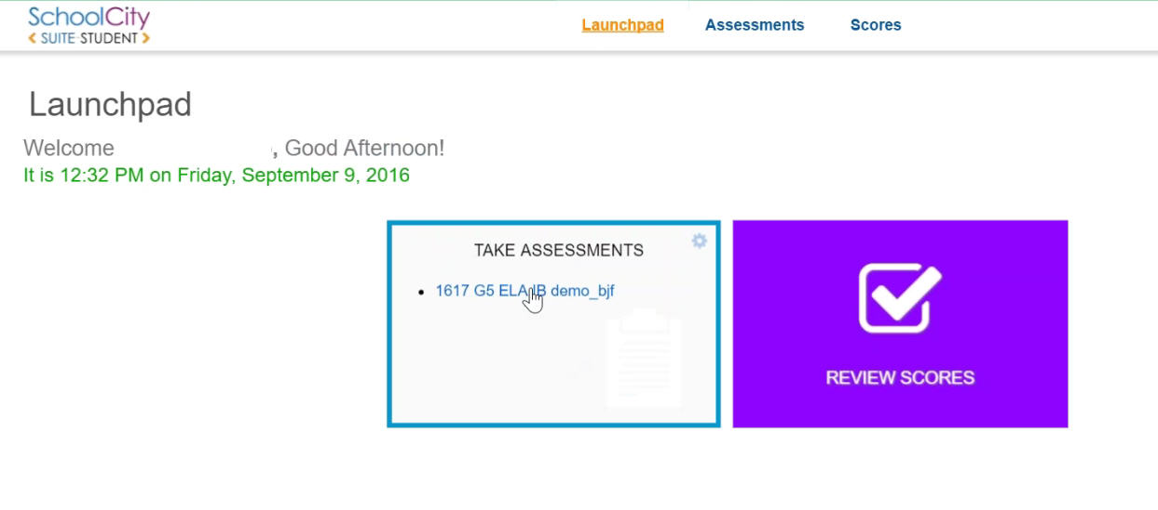
Student Launch Pad
Accessing Assessments
Flip Card

Slide 4
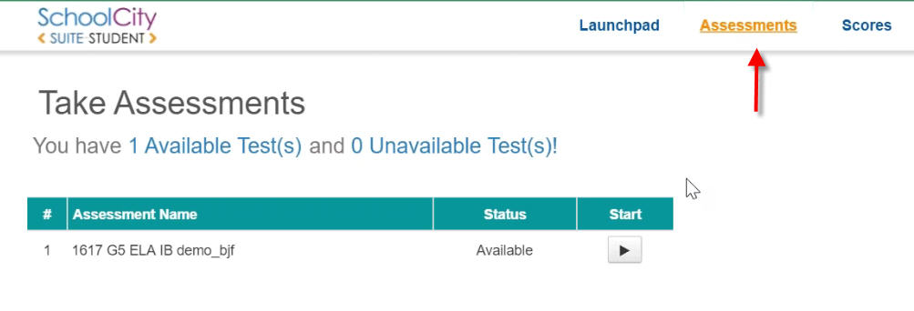
Student Launch Pad
Accessing Assessments
Tool Bar

Slide 5
Taking the Assessment

Slide 6
Taking the Assessment

Slide 7
Taking the Assessment

Slide 8
Taking the Assessment
Text to Speech is not available for ELA assessments

Slide 9
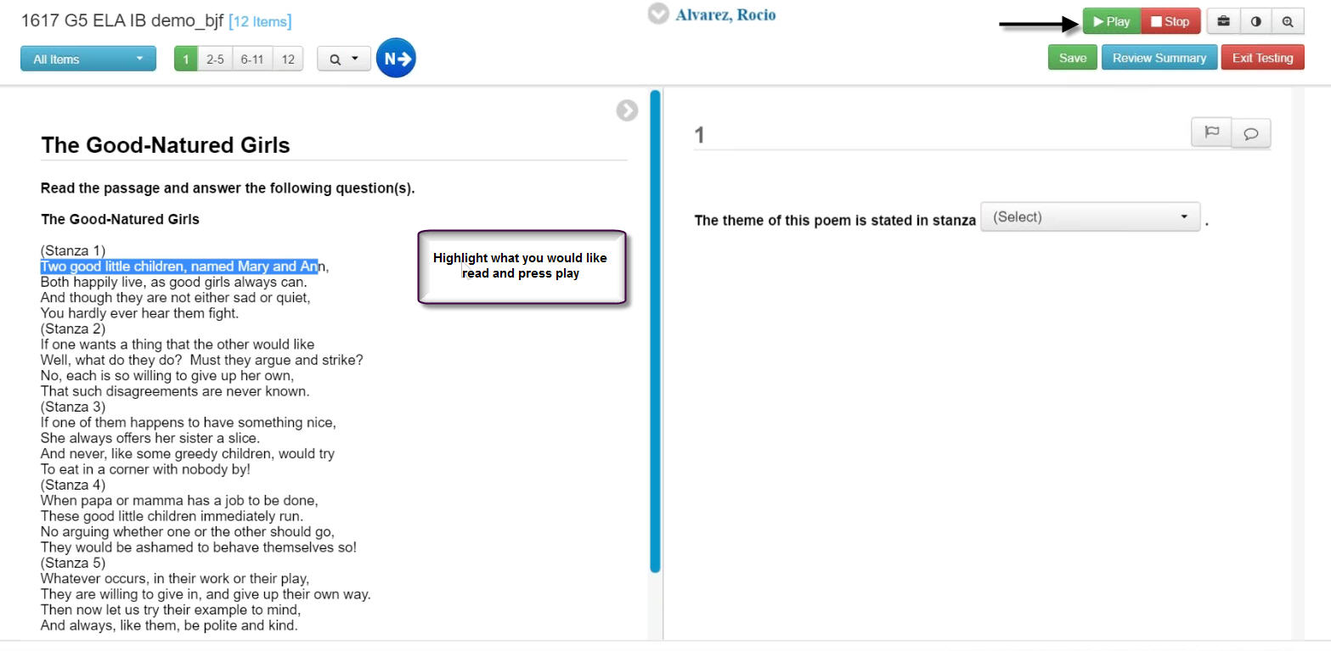
Taking the Assessment
Text to Speech is not available for ELA assessments

Slide 10
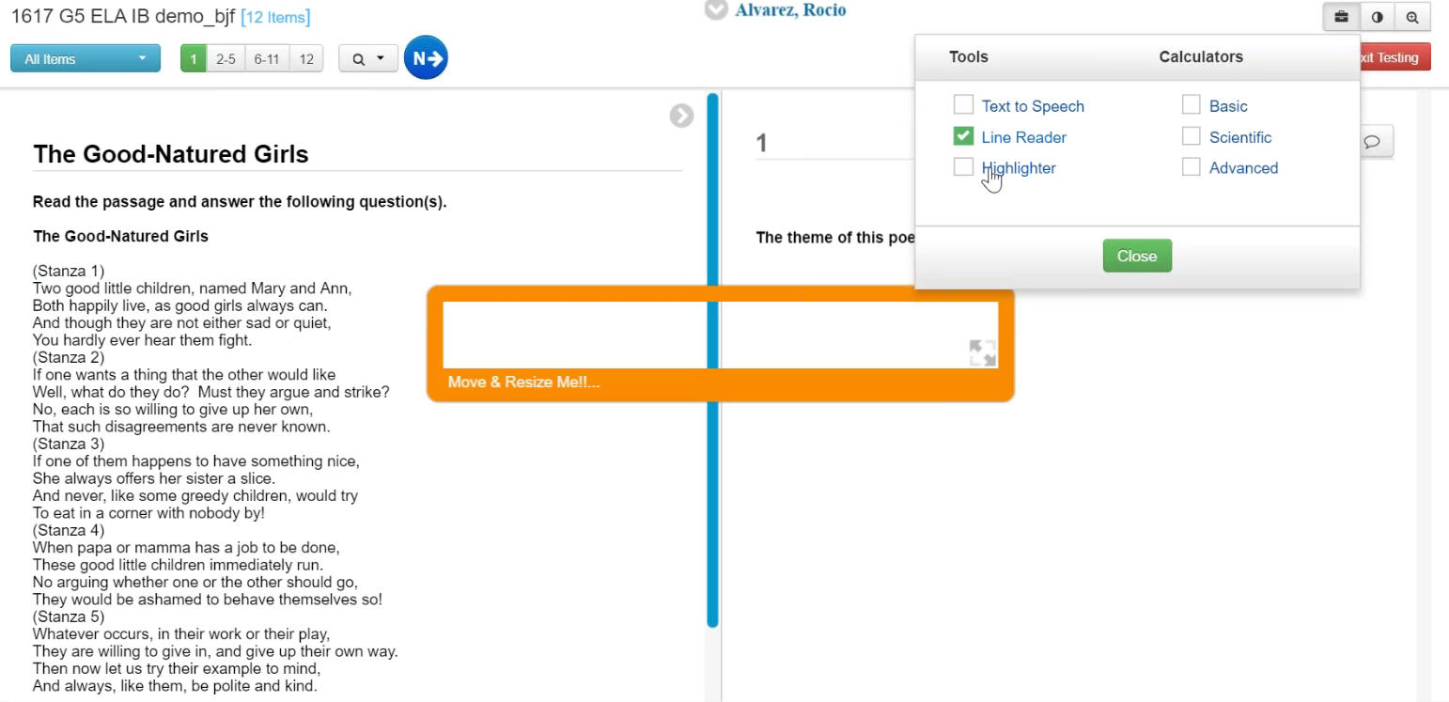
Taking the Assessment
Line Reader

Slide 11
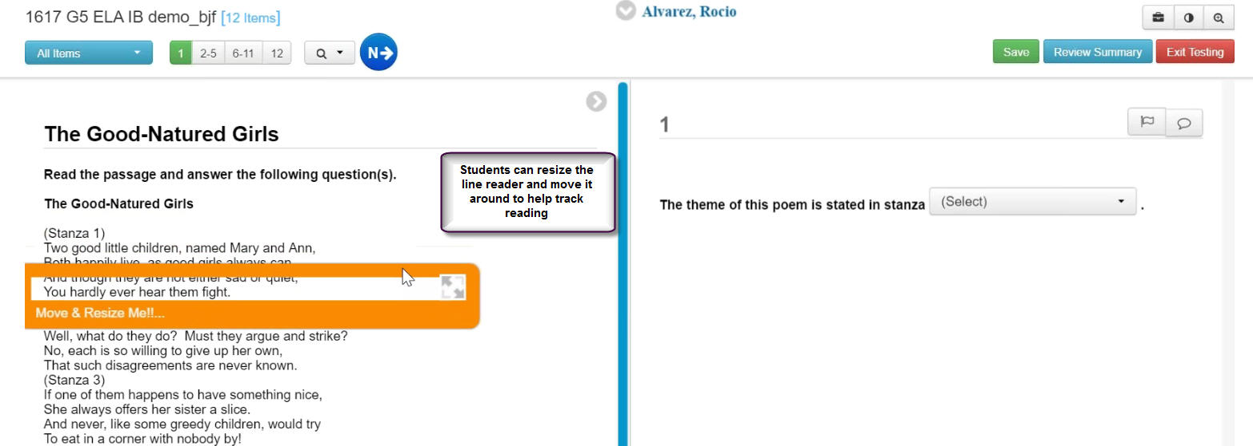
Taking the Assessment
Line Reader

Slide 12
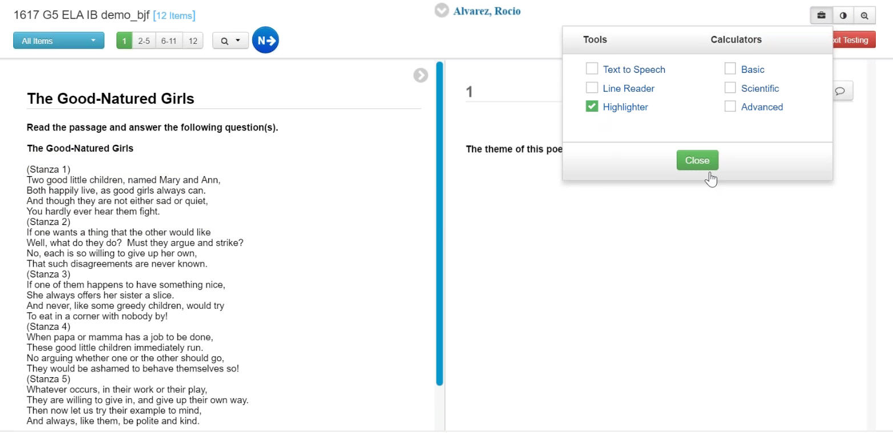
Taking the Assessment
Highlighter

Slide 13
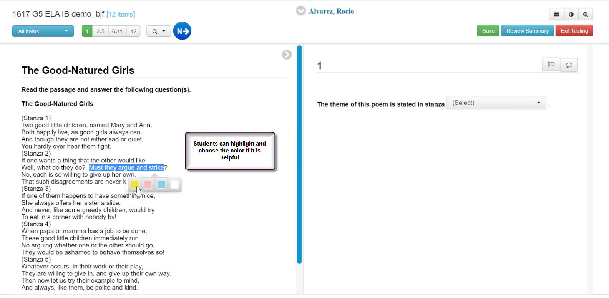
Taking the Assessment
Highlighter

Slide 14
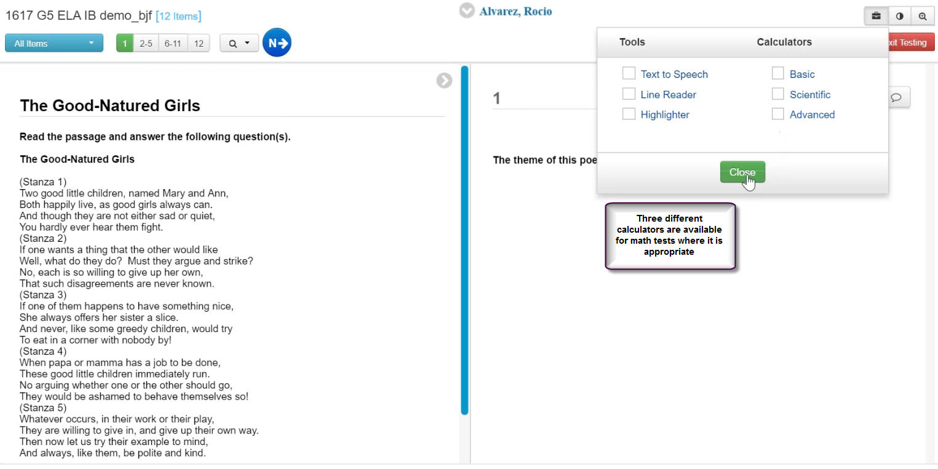
Taking the Assessment
Calculators

Slide 15
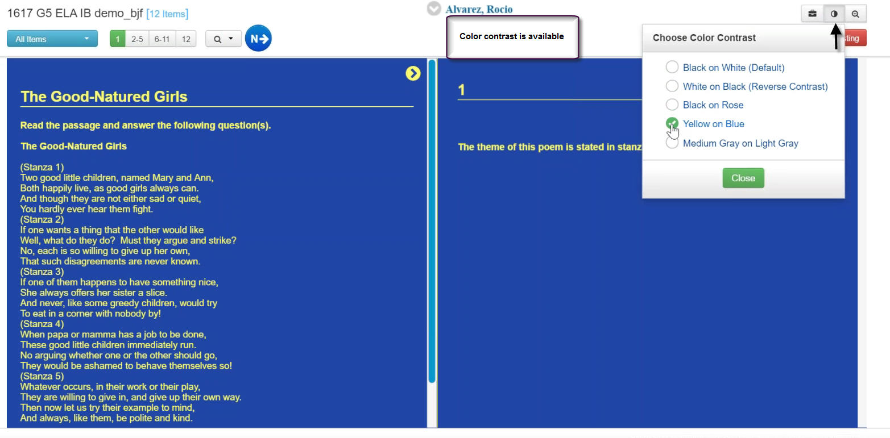
Taking the Assessment
Color Contrast

Slide 16
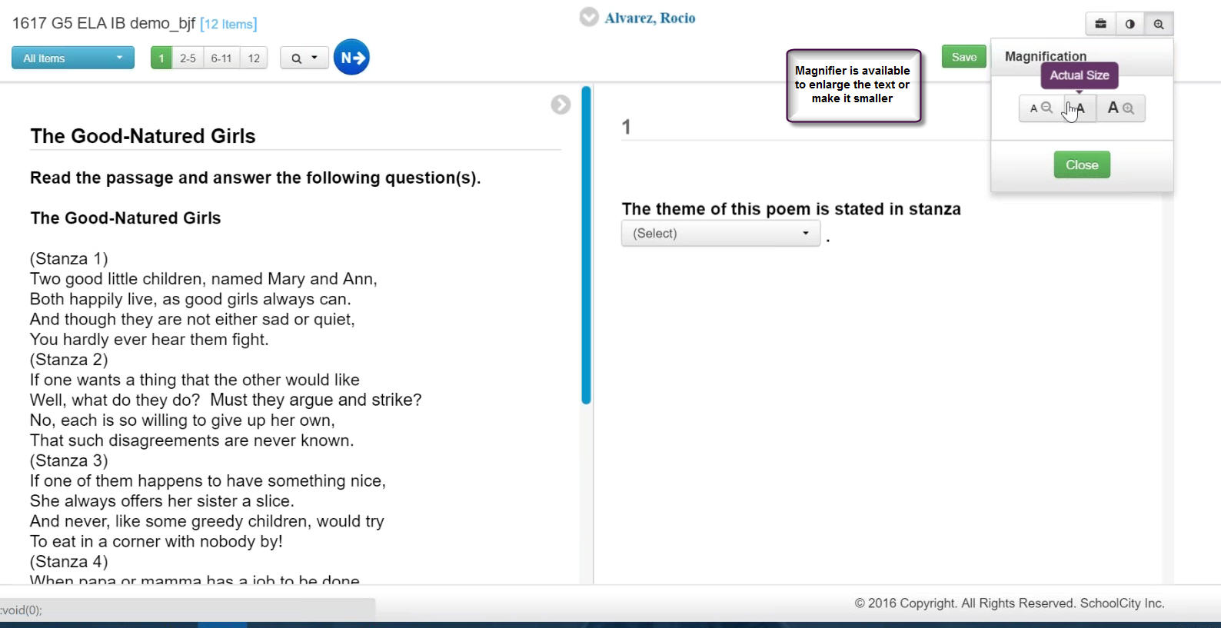
Taking the Assessment
Magnifier

Slide 17
Taking the Assessment
Flag an Item

Slide 18
Taking the Assessment
Notes

Slide 19
Taking the Assessment
Answer Eliminator

Slide 20
Taking the Assessment
Completing the Test

Slide 21
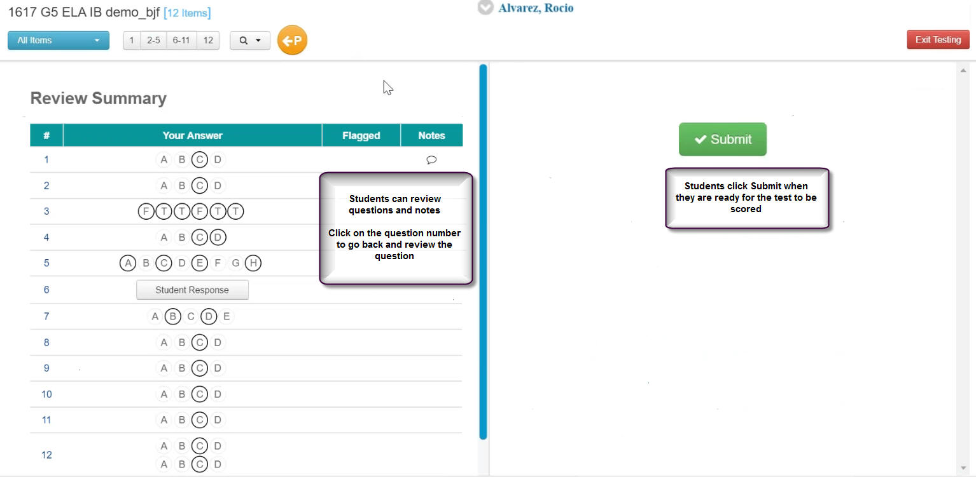
Taking the Assessment
Completing the Test

Slide 22
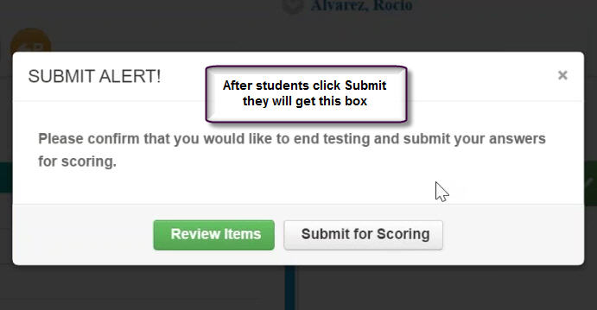
Taking the Assessment
Completing the Test

Slide 23
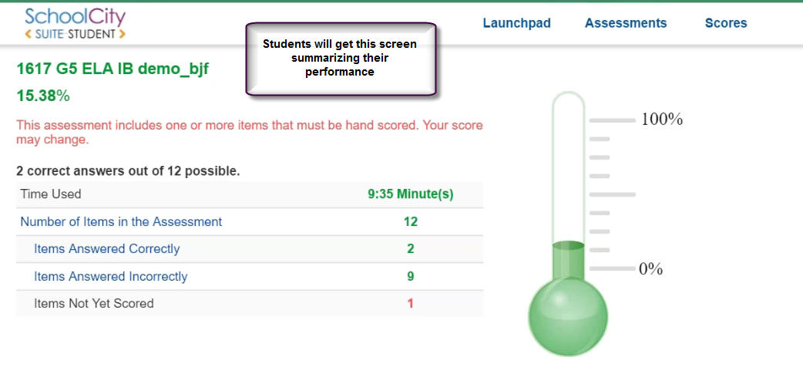
Taking the Assessment
Completing the Test

Slide 24
Taking the Assessment
Completing the Test

Slide 25
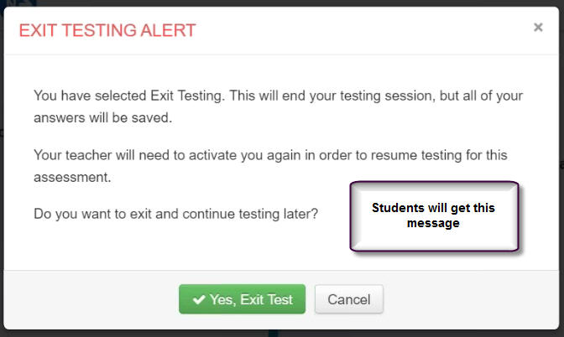
Taking the Assessment
Completing the Test

Slide 26
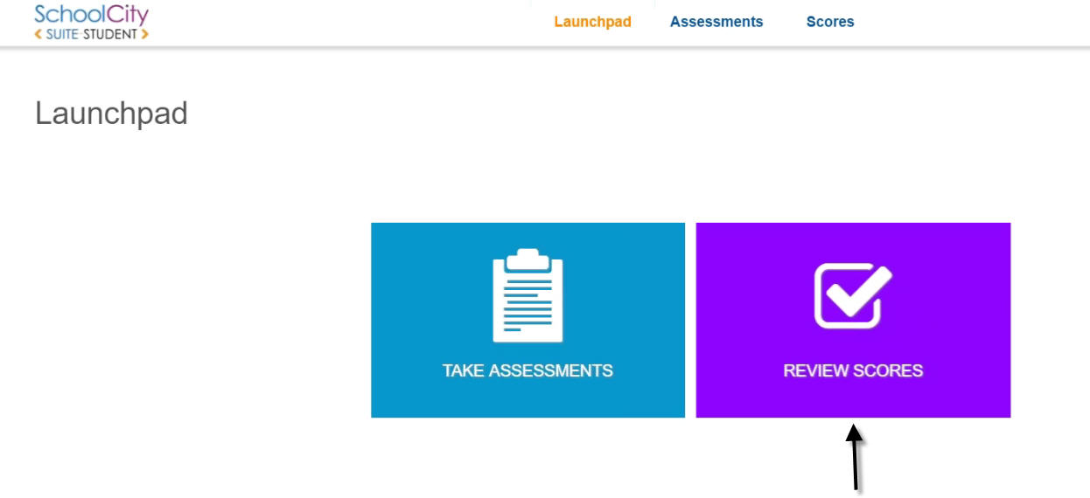
Taking the Assessment
Students can review their scores
Click on the Flip Card “Review Scores”

Slide 27
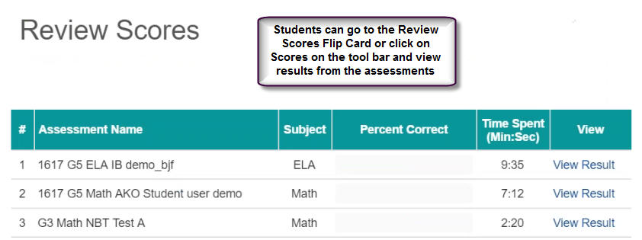
Taking the Assessment
Students can review their scores

Slide 28
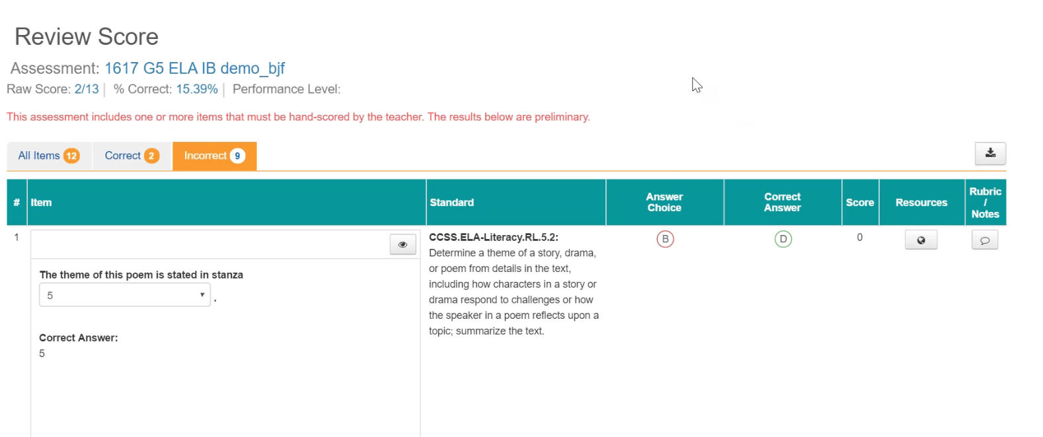
Taking the Assessment
Students can review their scores

