Slide 1
Creating Assessments

Slide 2
Items chosen based on standards
Using a test already created not using SchoolCity

Slide 3
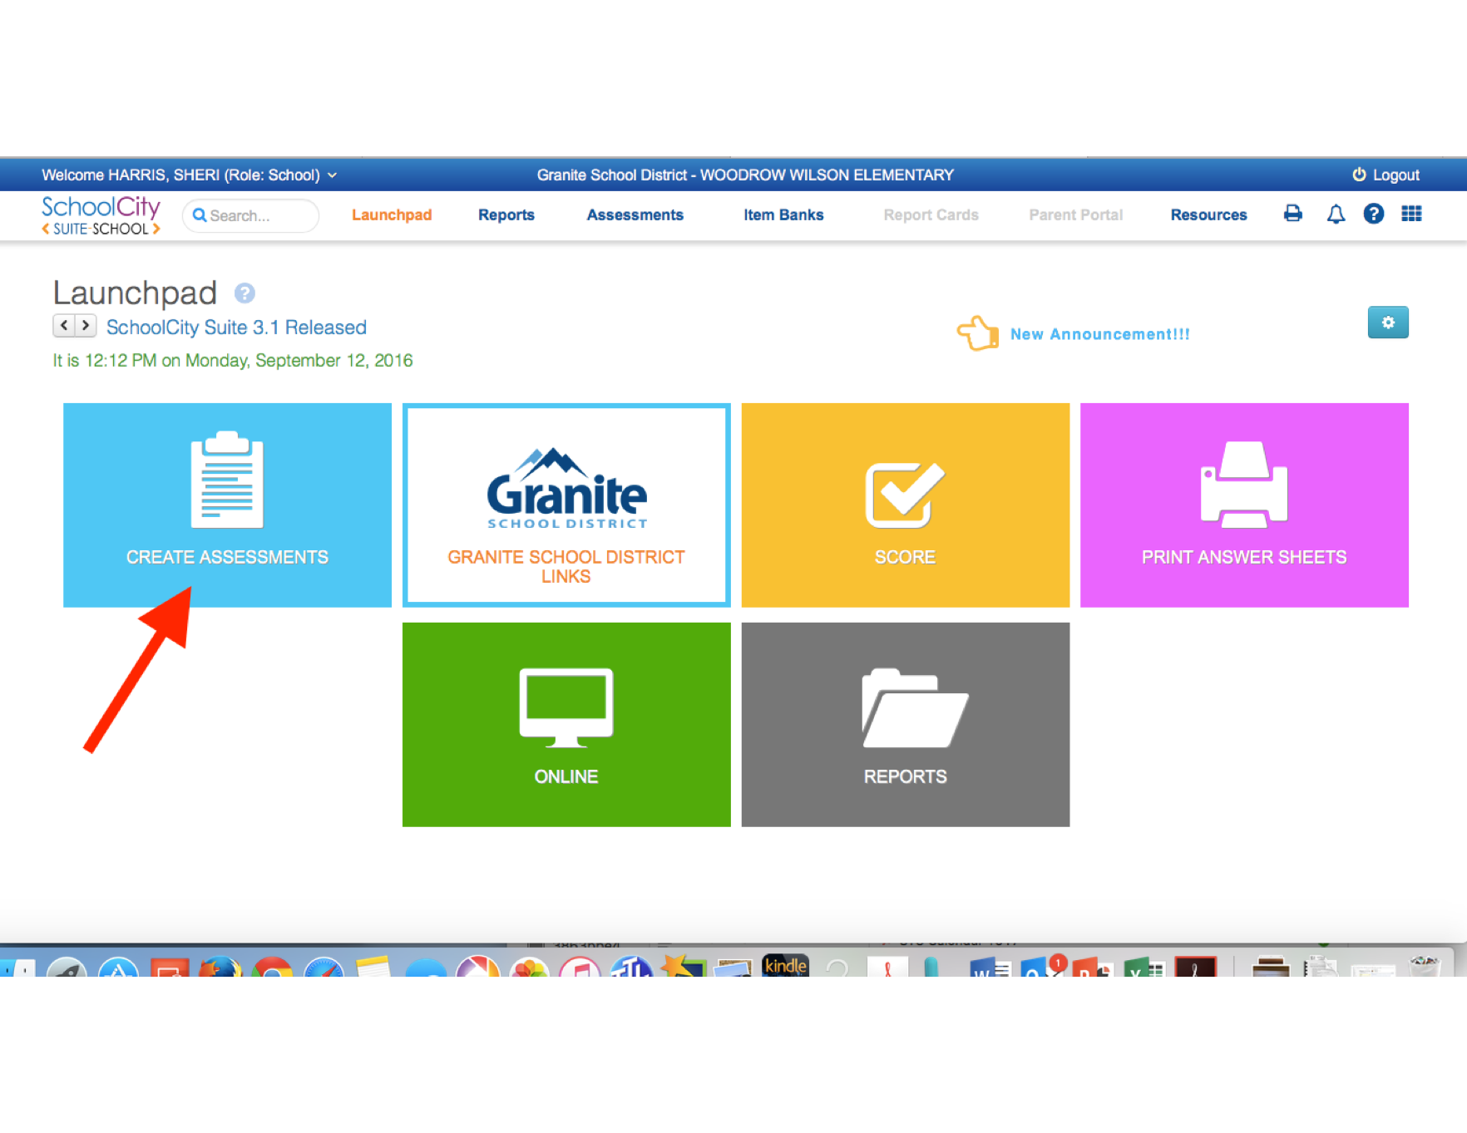
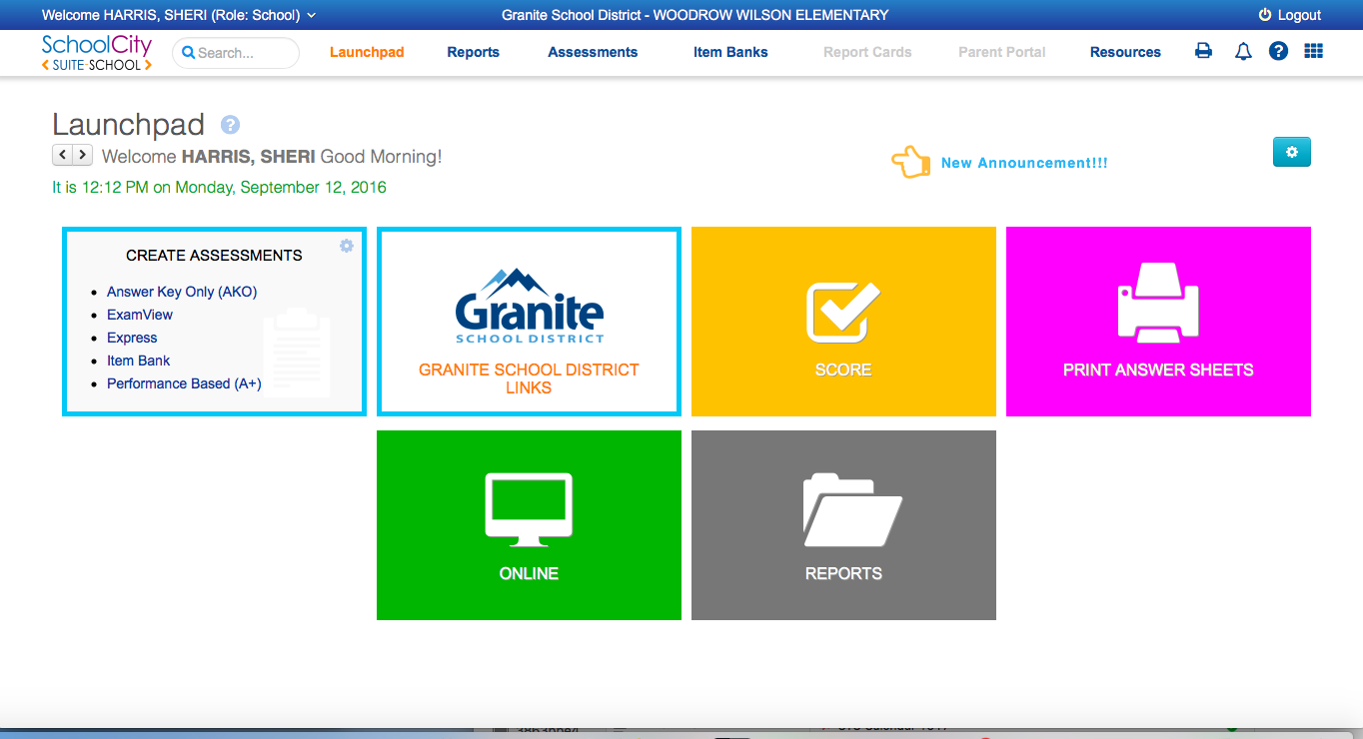
On your Launchpad, click CREATE ASSESSMENTS
Click on the type of assessment you want to create.

Slide 4
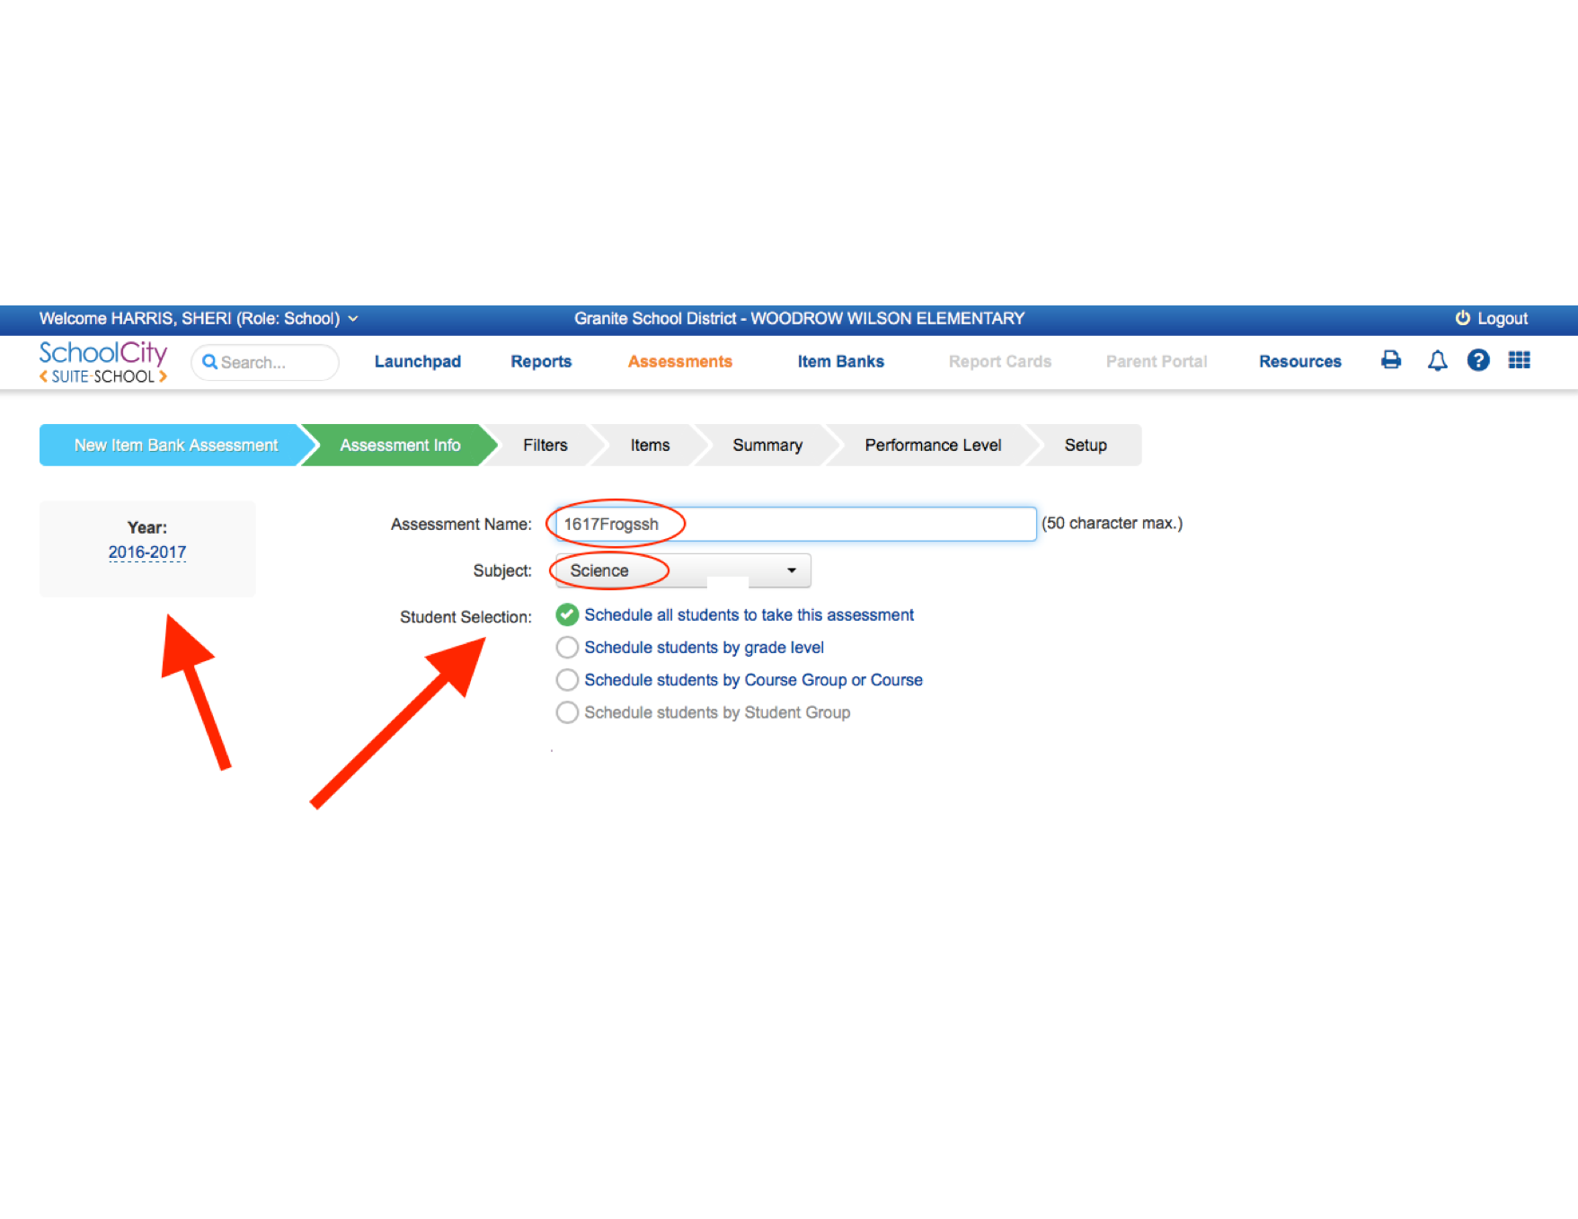
Make sure the year is current.
Choose a VERY unique and specific name.
Choose Subject
Select which students will take the test.
Assessment Info
Teachers will also be able to select the Assessment Level such as My Assessments, or School which determines whether they can share with others.

Slide 5
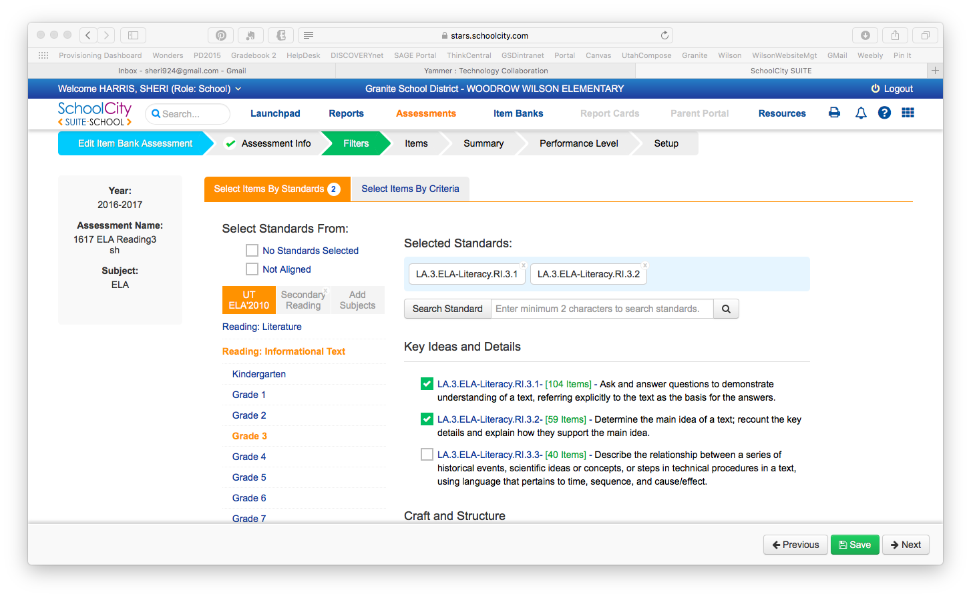
Two Ways to Choose Items
Select items by Standards
Choose Standard Areas
Choose Grade Level
Choose Standards

Slide 6
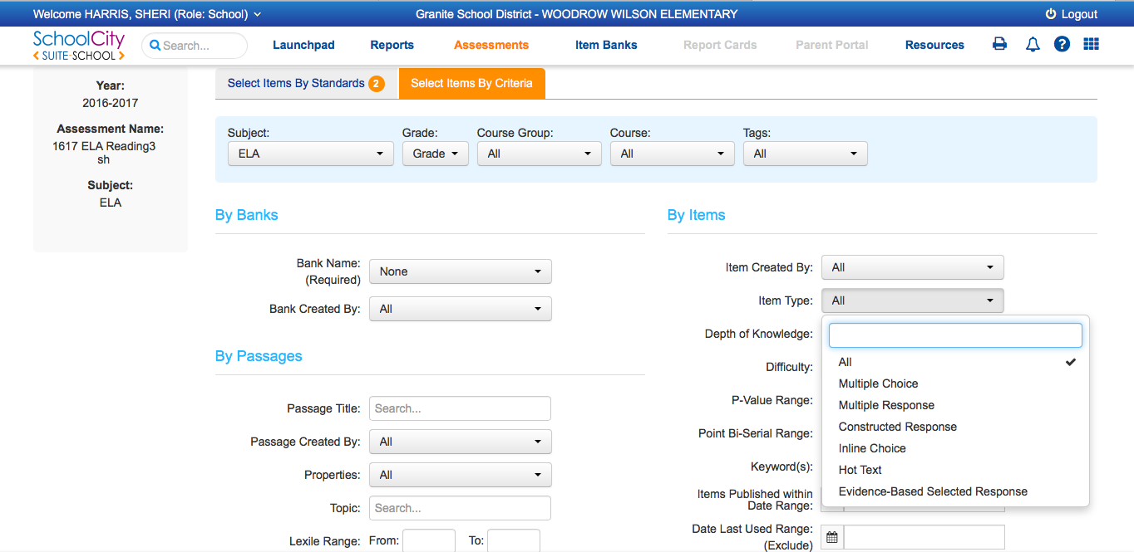
2. Select Items by Criteria
Choose Appropriate Filters as desired
Some item types may not be available for certain curriculum areas

Slide 7
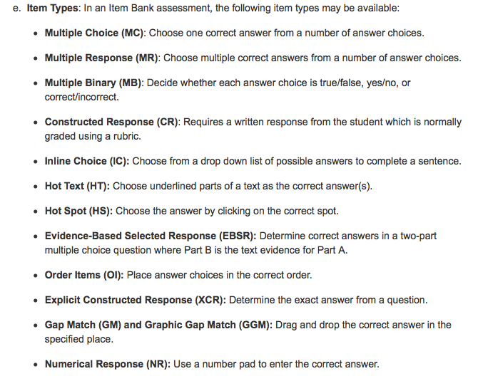
Item Types
A Brief View…
A More In-Depth View…
Click on link below.
Item Type – General Overview

Slide 8
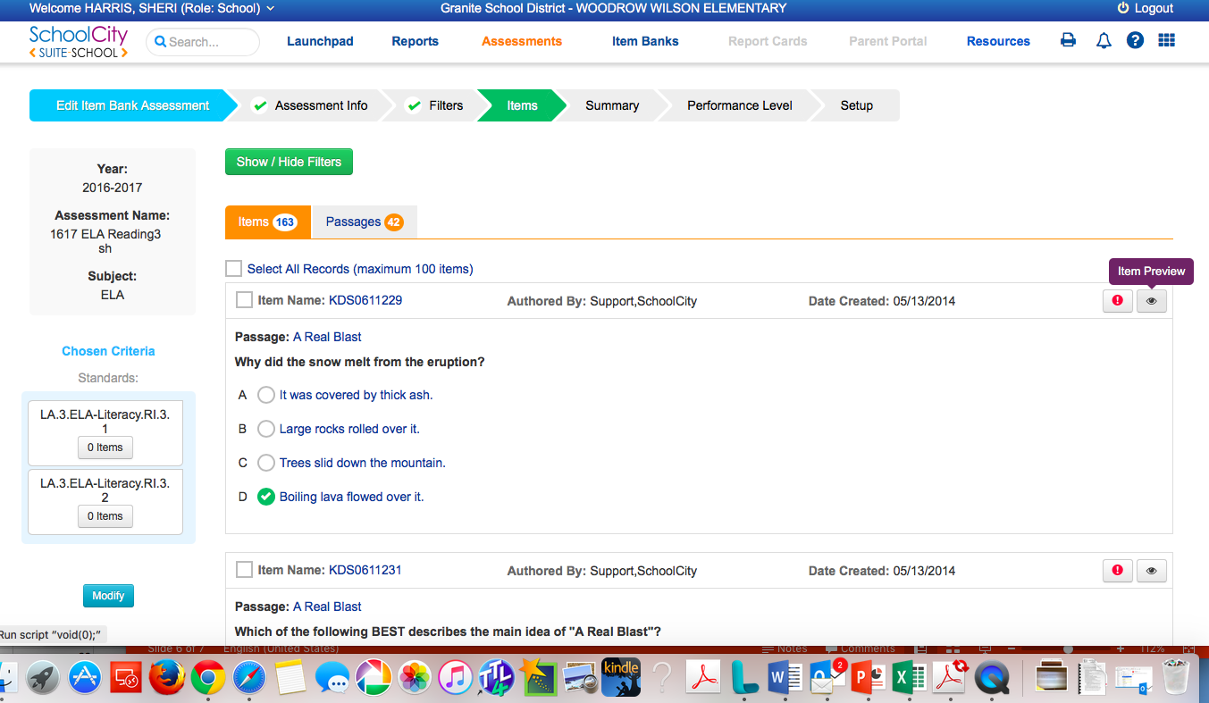
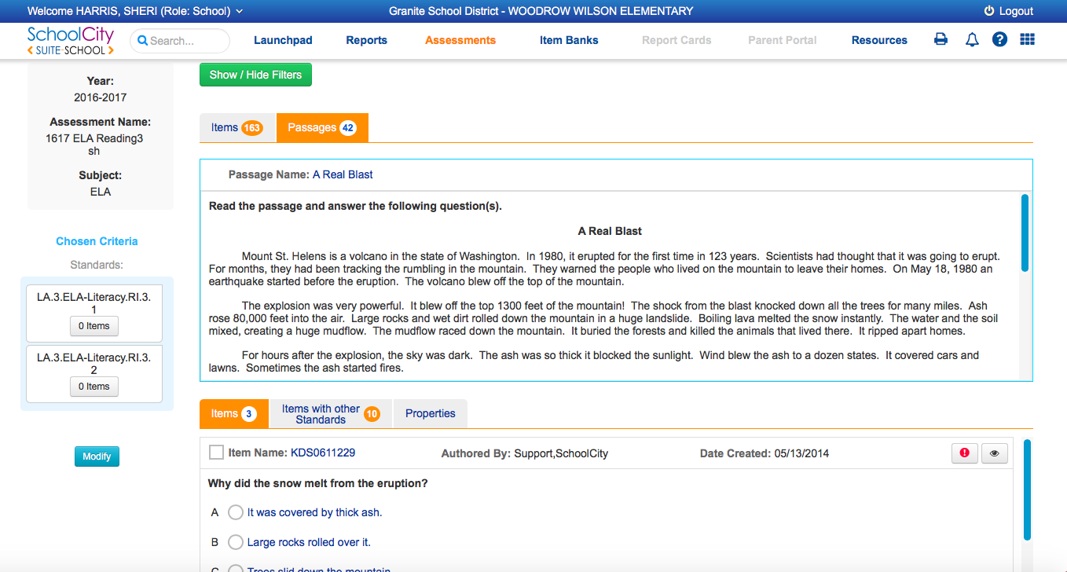
Once you’ve decided how to narrow your choices, you can view …
By Item
By Passage

Slide 9
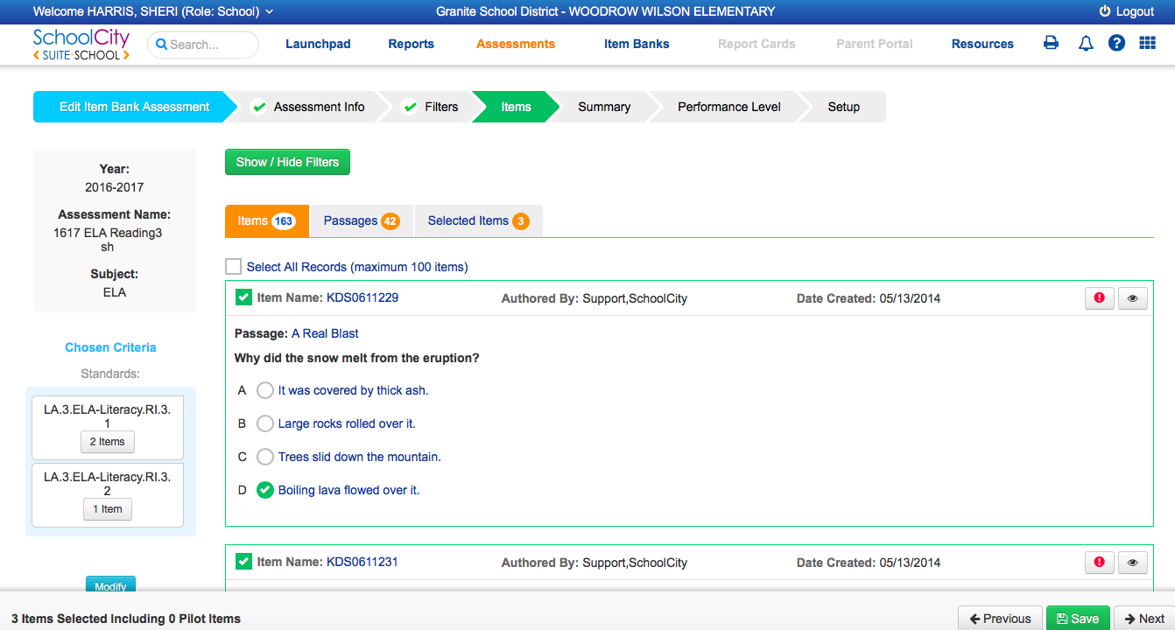
Select the items…
Select your items by clicking next to the Item Name
As you select items, you will see a count under the applicable standards.
When finished selecting, click Next

Slide 10
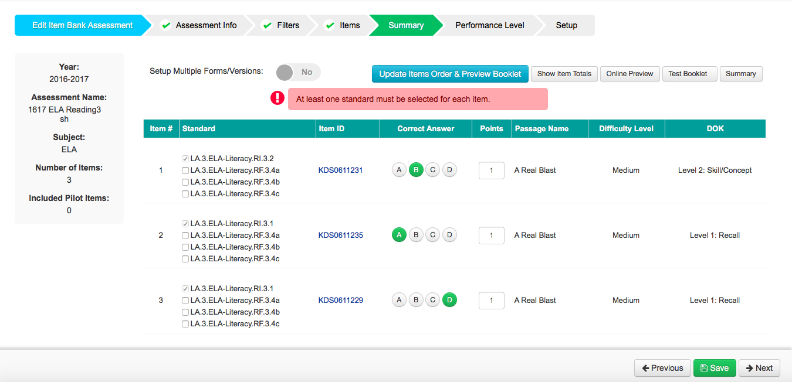
SUMMARY
Change item order
Online Preview
Rubric Rationale
Change Point Value
When finished, click Next

Slide 11
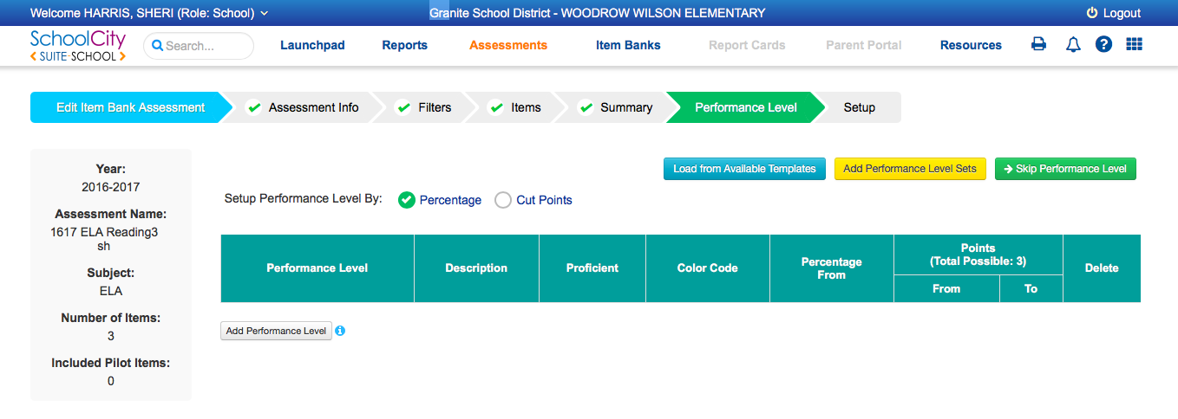
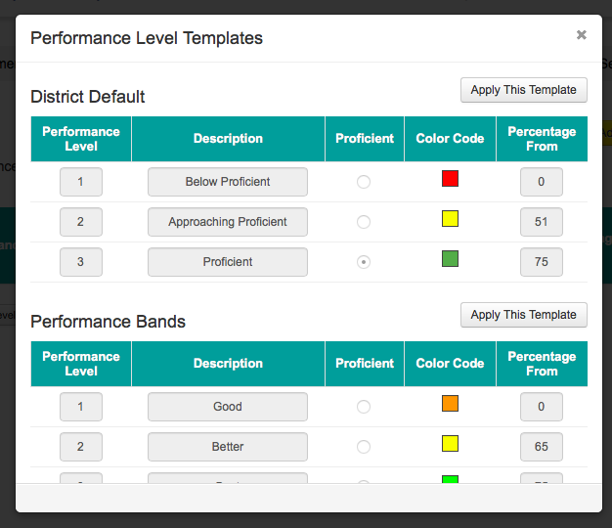
Performance Levels are optional!
To Skip
District Template

Slide 12
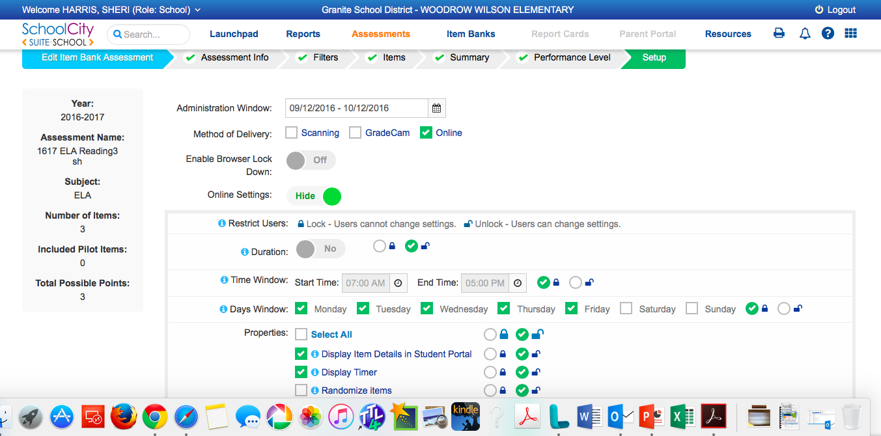
Setup (Administrative Details)
30 days from “today” default
Choose 1 or More
Online Settings
Choose one →

Slide 13
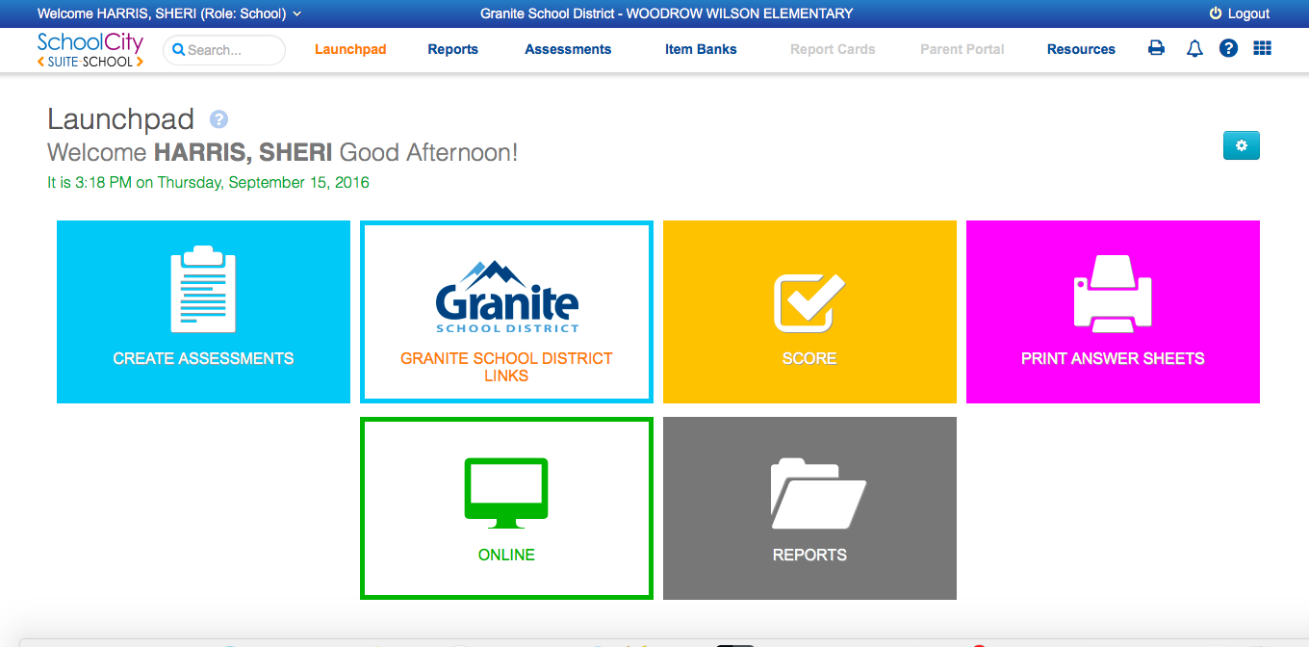
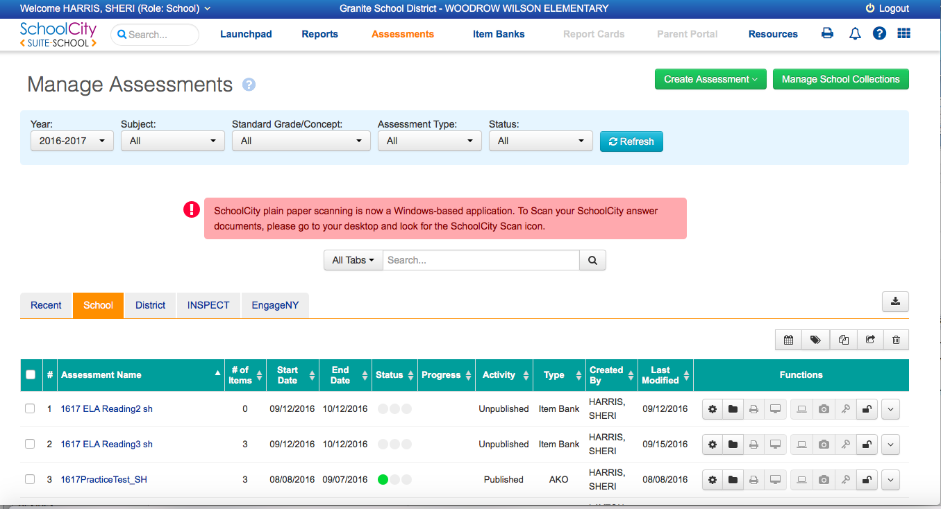
Assessment Manager
Find and Edit Assessments through the Manager
Find assessment in list
Check the box to the left
Click on the wheel next to Last Modified column

Slide 14
One last thing…
SchoolCity has a GREAT help menu! Access by clicking on the ? on the right-hand side of the top toolbar.
You can also call their Support line at (800)615-0254

